Slide 1
Using the SCC
)
Research Computing Services
https://rcs.bu.edu
Information Services & Technology
Notes:
A 2 hour hands-on intro to Python for physics REU students.

Slide 2
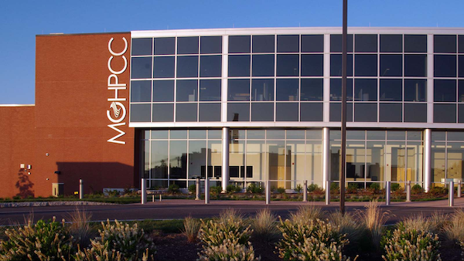
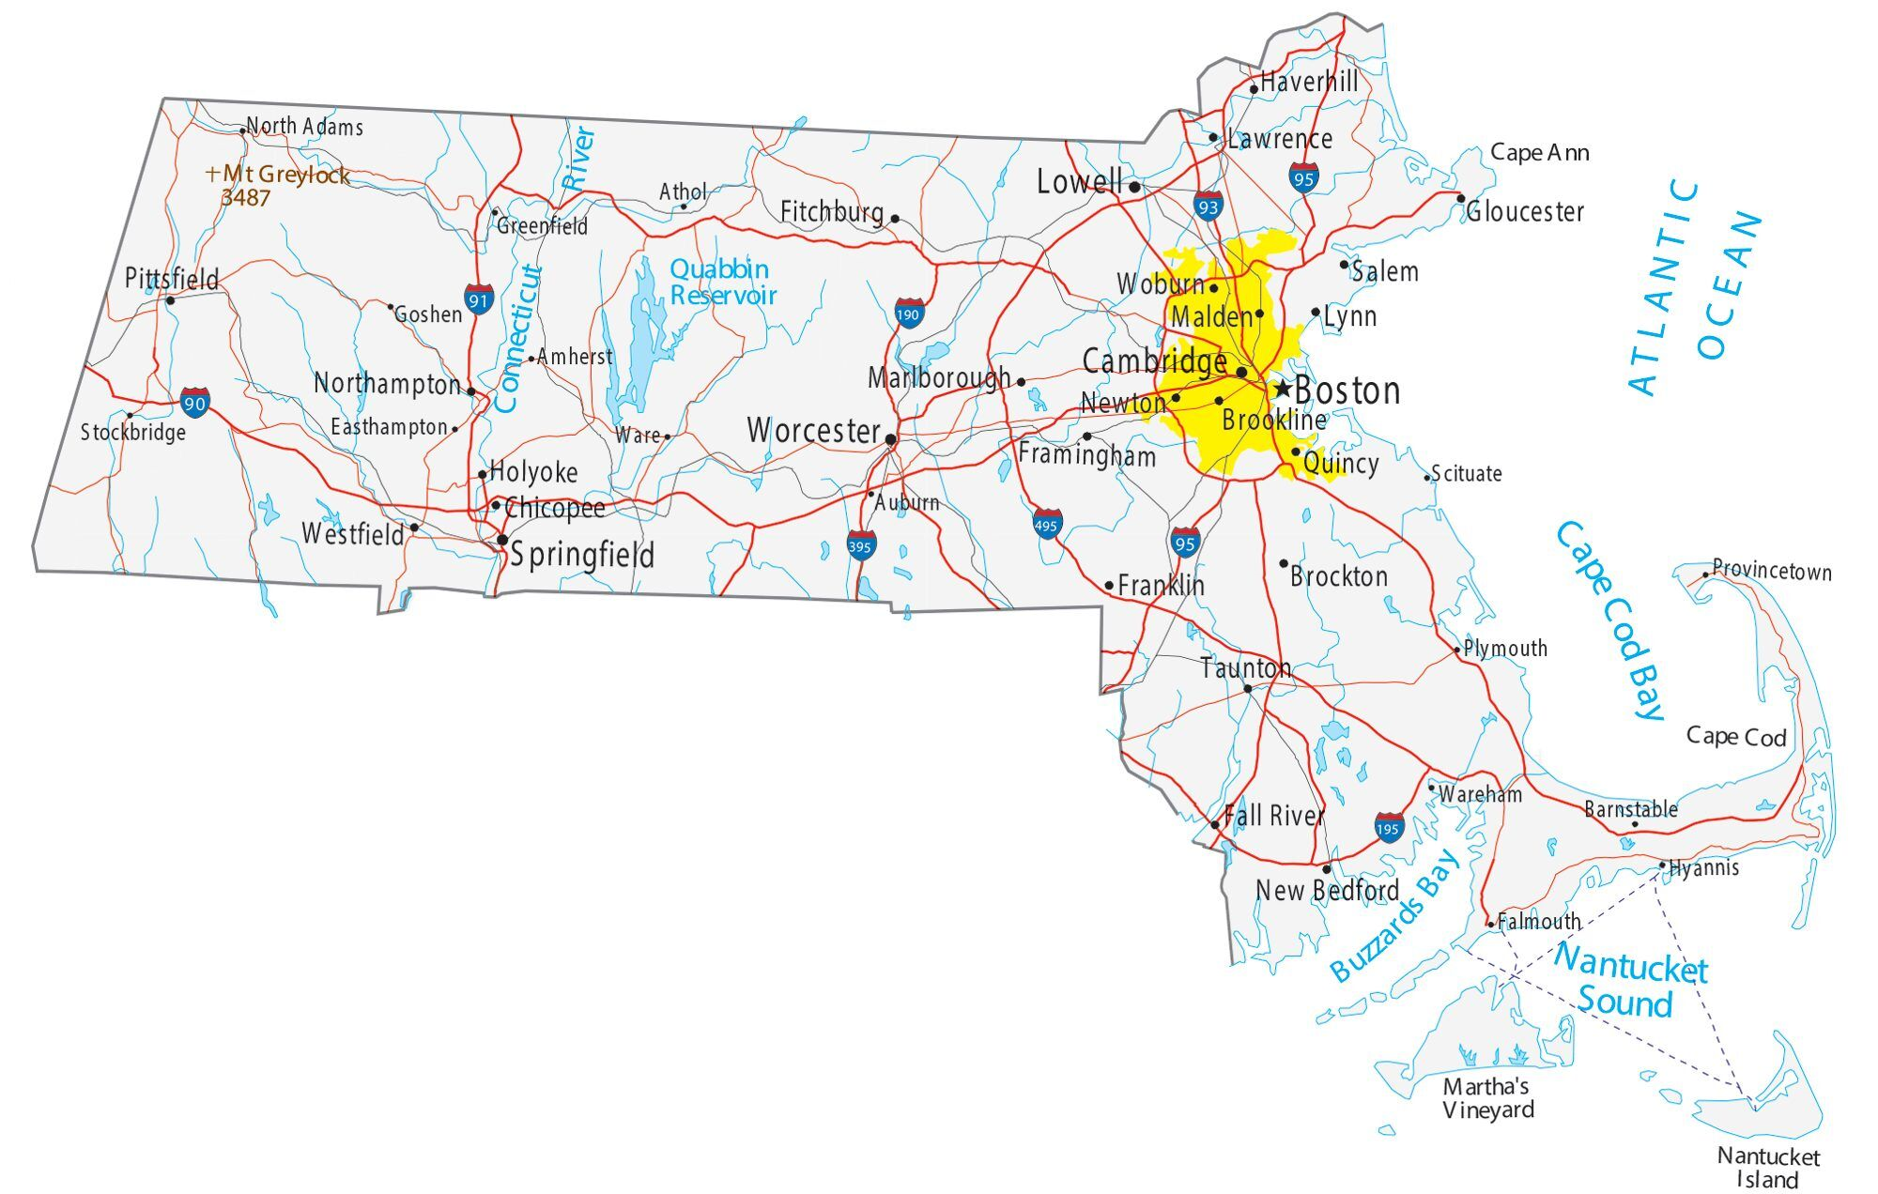

BU Shared Computing Cluster (SCC)
Located at the MGHPCC in Holyoke, Massachusetts.
  Alongside clusters from Harvard, MIT, NU, Umass, URI, and Yale
1070 compute nodes (servers)
  >30,000 CPU cores
  >500 GPUs
  ~16.6 PB of storage
BU’s Research Computing Services group maintains the BU SCC.
Notes:
Construction 2011-2012, officially opened in Nov. 2012.

Slide 3
SCC Access
SCC OnDemand is the easiest way to access the SCC:
Google Chrome is the recommended browser
  This browser properly handles copy & paste in OnDemand Desktops.
Beyond interactive use:
  You can create and submit non-interactive “batch” jobs to the cluster job queue.
https://scc-ondemand.bu.edu

Slide 4

Do not use the “BU Guest” WiFi network to access OnDemand.
  The interface will break, and it will be unusable.
Use the eduroam WiFi network
  Or, even better, a wired Ethernet connection in a BU office or dorm room.

Slide 5
Links to RCS Documentation
File transfers to/from your own computer.
OnDemand documentation
Batch (non-interactive) Jobs
Linux guide for SCC users.
Linux usage quick reference.
Quick reference for SCC commands.
Home directory quota (just 10GB) is full? Start here.
If your professor and/or TA has asked you to submit a help ticket to us, fill out the form here.
  Choose “Research Computing” in each box, then describe your problem in as much detail as you can.

Slide 6
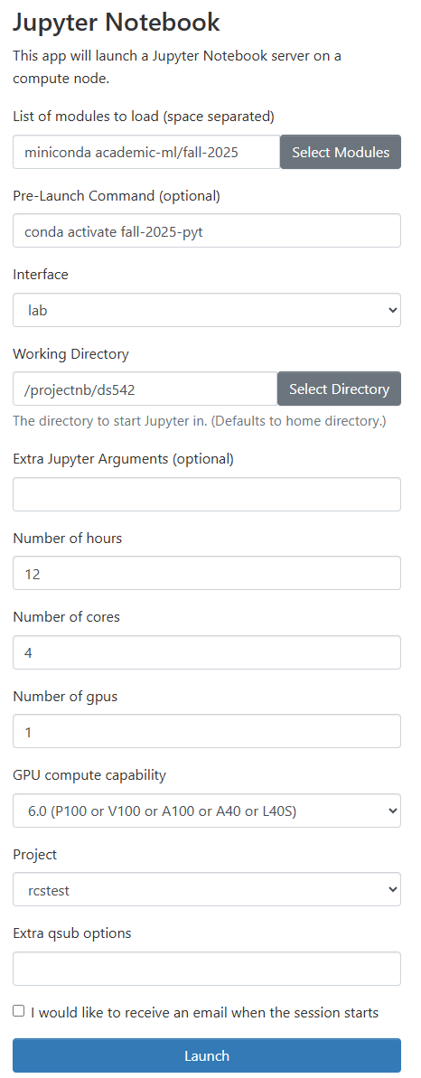
OnDemand Jupyter
Load the miniconda and
academic-ml/fall-2025 modules
Pre-launch command:
  conda activate fall-2025-pyt
  This is a PyTorch-based conda environment.
Choose 4-8 cores and 1 GPU when using a GPU
  4 is usually plenty
  Request just 1 GPU
For CPU-only, choose 4 or 8 cores.
ds542

Slide 7
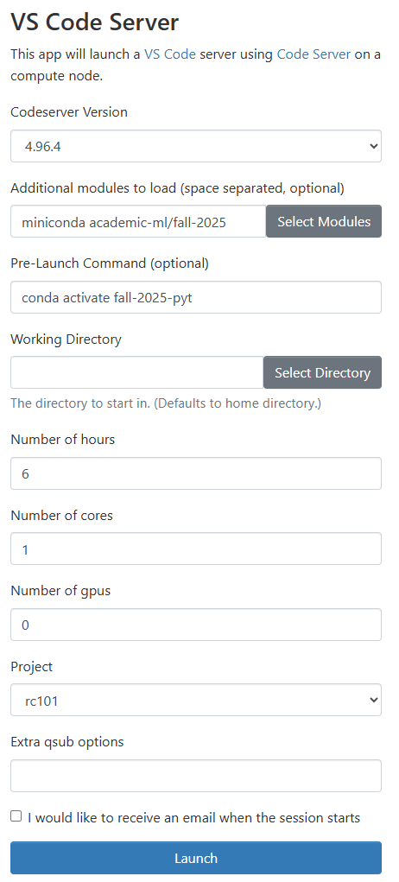
OnDemand VS Code Server
Code Server is open source, based on Microsoft VS Code, it runs in your browser.
Same setup options as Jupyter
Important: the Code Server extension marketplace is NOT the Microsoft one you see with VS Code on your laptop.
  Practically speaking, this means that Github Copilot is not available.
ds542

Slide 8
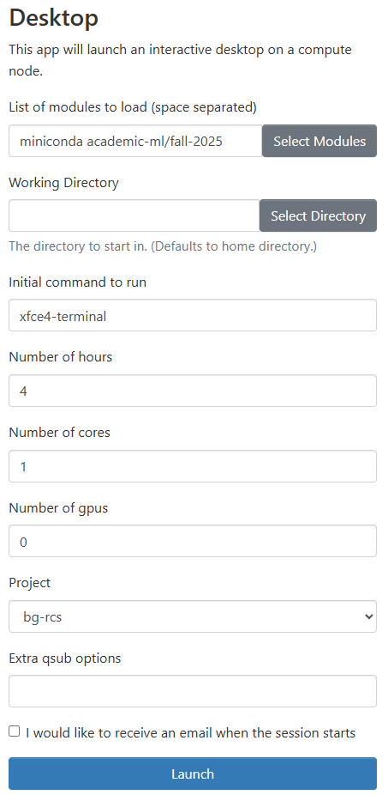
OnDemand – start a Desktop Session
Same setup for the number of hours, cores, and GPUs as the other two.
To activate the PyTorch environment execute this in a terminal:
conda activate fall-2025-pyt
To run genuine Microsoft VS Code:
  module load vscode/1.99.2
  code
To run Jupyter:
  jupyter notebook
  OR
  jupyter lab
ds542

